Slide 1

Leading A Spiritual Life:
Self- Realization

Slide 2

It’s a supplemental doc!
Please read the newsletter before conducting the study circle with this document.

Slide 3
Overview
Introduction Video
Essential Components to Self Realization
Digging Deeper with Thoughts
Digging Deeper with Images
Prema Vahini

Slide 4

Materials Needed (for the moderator):
Copy of the newsletter document (for reference)
Ability to play an audio recording
Pencils/pens and paper for notes and activities

Slide 5
Journey from Self-Confidence to Self-Realization
Over this past year, we’ve traveled through different topics beginning with self-confidence that have ultimately brought us to this topic of self-realization.
Refer to the newsletter document section II (Self Confidence to Self Realization) now to read an experience of love from one of our young adults as they journey through the 4 topics (self-confidence, self-satisfaction, self-sacrifice, and self-realization) covered this year.

Slide 6
Introduction to Self-Realization
What is Self-Realization?: Refer to the newsletter document section III now to find out more!
Why Self-Realization?: Refer to the newsletter document section IV to find out why.

Slide 7
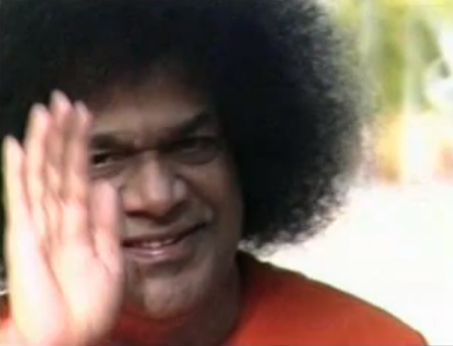
Introduction to Self-Realization
We present an audio recording of Swami singing verses on the nature of the Atma or Self. As we listen to the recording, let us ponder on the import of each word (lyrics and meanings on next slide):
  To play this file, exit out of presentation mode and play from normal/slide mode by double-clicking on the icon below
  If you have trouble playing this audio link, please play the mp3 file attached in the email sent to all YAs with the newsletter and study circle documents. The audio recording can also be found on saiyausa.net.

Slide 8
Introduction to Self-Realization
Lyrics | Meaning
Na Punyam Na Papam; Na Saukhyam, Na Dukkham | Neither sin nor merit; neither pleasures nor pain.
Na Manthra Na Tirtham; Na Veda Na Yajnam, | Neither sacred formulae nor sacred places; Neither Vedas(scriptures) nor yajnas (rituals or sacrifices).
Aham Bhojanam Na bhojanam Na Kartau, | I am not the act of enjoying, nor the object of enjoyment nor the enjoyer,
Sadananda Rupam Advaitam; Sathyam Sivam Sundaram; Sadananda Rupam sivoham sivoham | I am the ever blissful One, One without a second; Truth, Goodness and Beauty; I am the nature of pure consciousness, bliss absolute. I am verily Shiva. I am THAT.

Slide 9
Essential Components/Paths to
Self-realization
Refer to newsletter document section V (“How do we attain the state of self-realization?”) and section VI (“Essential Components/Paths to the Goal”) now to discover the essential components of Self-Realization.

Slide 10
3 Paths to Self Realization
Please read the following excerpt of a conversation between Dr. Hislop and Swami (follow up discussion on next slide):
Hislop: One hears about various paths to Self-realization. What does this mean?
SAI: There are three paths. There is that of devotion; the Guru guides and all is left to the Guru to perform. Then, there is the perception that God is Omnipresent; the future comes up to the present and the past falls away from the present. God is omnipresent; so the present is God; this is knowledge. Then there is surrender to God. But surrender does not mean just doing all actions in His Name. Surrender to God is when the entire Universe is known as His body. Surrender is when doer, deed and object are all God. It cannot be forced. It comes naturally. Faith is the foundation; surrender is the peak.
Hislop: Of the many 'roads' to self-realization, what is the short cut?
SAI: The short cut is this way: the Name of God is the seed; love is the water by which the crop grows; discipline is the fence which protects the growing crop; the field in which the crop is grown is the spiritual heart; the crop when it comes to harvest, is Bliss.”
Source: (http://media.radiosai.org/journals/Vol_03/05MAY01/cws.htm)

Slide 11
Summary of the 3 Paths
Swami says there are three primary paths to Self-Realization:
Swami talks about surrender in the previous slide. Where does surrender fit in the 3 paths above?
Do these 3 paths overlap at any point or are they each mutually distinct? Which one do you feel applies to you personally?
Self Realization
Service
Devotion
Knowledge

Slide 12
Digging Deeper with Quotes on Self-Realization

Slide 13
Read, reflect, discuss the following quotes from Swami
“What is realization?...Look in the mirror and see your own image; you assert, “That image within is mine; but I am different’. The image of the sun in the water shakes, though the sun is steady, up above; that is the nature of the water, not the Sun…You do not believe that dreams indicate reality, because the dream is negated on waking. When you get Jnanam (the highest wisdom), the waking experiences will be negated. Until then, you will take all this as real; after that you will find that this has only relative value” - Sathya Sai Baba, SSS VOL IV Chap 28
“You are the image of the Supreme Self, the image that is reflected in the body that is part of Nature. It is to discover in and through this agitated world the peace that is your birth-right and utilize that peace of the illumination of the heart, which will reveal the splendor of the Self which you really are” – Sathya Sai Baba, BTBOS p77

Slide 14
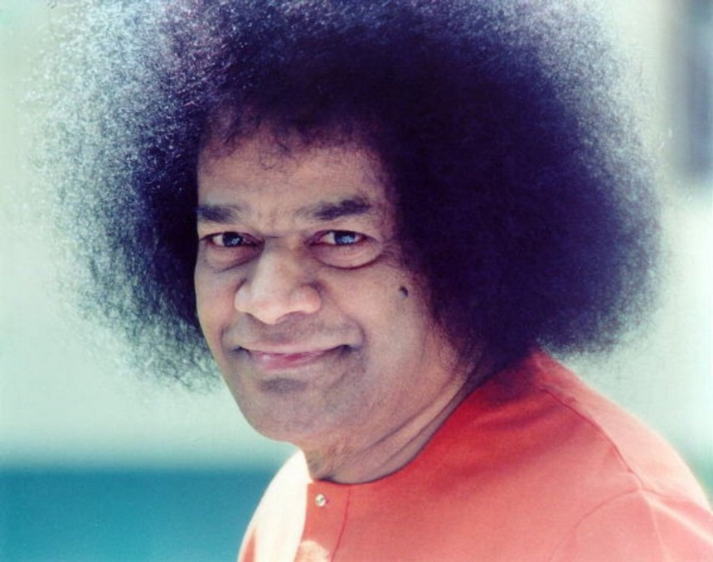
Read, reflect, discuss the following quotes from Swami
"How can one get the crop without the cultivation? Like cream in milk, like fire in fuel, the Lord is in everything, more or less. Have full faith in this. As the milk, so the cream; as the fuel, so the fire; so also, as the sadhana, so the Sakshathkaara (Self-realisation), is it not?" - Sathya Sai Baba, Chapter 30, Prema Vahini

Slide 15
Digging Deeper with Images on Self-Realization

Slide 16
Digging Deeper: Images on Self Realization
Discussion Questions:
The plug serves as a source of energy for the light. What is your spiritual “plug”?
The cartoon shows that the light is on even though the cord is not plugged into an outlet? How does this relate to self realization?
Notes:
Image to be recreated

Slide 17
Digging Deeper: Images on Self Realization
Discussion Questions:
Is the goal of self-realization to see Swami in yourself?
At this point in time, do you see Swami as your reflection in certain moments? Describe those moments.
Notes:
Image to be recreated

Slide 18
Digging Deeper: Images on Self Realization
Discussion Questions:
How do the Young Adults interpret the concept of self-realization? Here is a collage of words that comes to many of our young adults’ minds when they think of the term, ‘self-realization’?
Are there any words here that you did not think would relate to self realization? Discuss those amongst your YA group.
harmony contentment GOD
liberation joy self-reflection peace love bliss oneness
I am I authenticity
omnipresent Atma consciousness detachment
truth honesty
Notes:
Image to be recreated

Slide 19
Digging Deeper: Images on Self Realization
Discussion Questions:
What aspects of self-realization does this cartoon depict?
Do we have moments where we try to find our true nature in external sources?
When does this happen?
Notes:
Image to be recreated

Slide 20
Digging Deeper: Images on Self Realization
I prefer being unaware of my bad qualities……..
Discussion Question:
What impurities hinder our attempts to look within ourselves?
Notes:
Image to be recreated

Slide 21
Digging Deeper: Images on Self Realization
‘When you cannot google the answer, come to me’ Conscience
Discussion Question:
Do we always look within for answers? If not, how can we consciously always practice this?
Notes:
Image to be recreated

Slide 22

Digging Deeper: Images on Self Realization
Discussion Questions:
What is self-realization according to you? Is it a one end-goal or is it imminent within you?
The last few newsletters have focused on self confidence, self satisfaction, and self sacrifice as building blocks for self realization. Do you view these as building blocks to self realization or as internal jewels that can be simultaneously discovered, thereby leading one to self realization?
Notes:
Image to be recreated

Slide 23
Practical/”Take Home” Tips for Self-Realization
The focus of this newsletter/study circle is to not just intellectually know we are God, but remember all living beings are God and transform our mundane life into Divine Worship. Practicing any one of these tips might be enough to remind us of our true nature (and others’ true natures) throughout the day. Which one resonates most with you?
Cues to remind us that we are God
We can attend regular Sai/spiritual center events so that God is more likely to be on our mind.
We can schedule a recurring reminder in our planner or digital calendar or put a reminder on our bathroom mirror to remind ourselves we are God every morning.
We can place Swami’s (or respective form one chooses to worship) picture on our desk or computer to remind ourselves we are God.
We can place a Japamala (rosary) in our pocket or purse so that when we find it throughout the day we remember to continually repeat God’s name.
Every month we can choose one of the 9 points in the 9-point code of conduct and focus on practicing that point each month.
Mindfulness
Swami has said, “Make your mind steady and still for as short a period as eleven seconds. You can attain realization even in such a short period. Realization cannot be achieved by becoming restless like a clock. Just eleven seconds of stillness of mind would be enough.” This has the power of helping us attain self-realization, as declared by Swami in the World Youth Conference, 2007.
Instead of leaving late for appointments or walking or driving with distractions (text/talk/email), we can start early and listen to inspiring music and experience “being” (vs. “doing”).
3. We can exercise (walk, run) or take a hike in nature to feel the one-ness with God’s creation.
Verbal or Mental Repetition/Contemplation
We can repeat, “I am God, I am not different from God,” as a prayer every morning and evening.
We can focus on the faults within ourselves instead of the faults in others and silently repeat “I love you and am grateful,” for any conflict which comes our way.
We can keep a journal or think back in retrospect on our ride home every day to recall all thoughts, words and acts, when we forgot our divine self and identified with our ego-self (felt perturbed).
*After choosing one tip to practice, contemplate, “Why might that tip help us practice self-realization?”*

Slide 24
Prema Vahini Quiz Answers
Read Chapters 24-31 from Prema Vahini (http://www.vahini.org/downloads/premavahini.html)
After reading, refer to newsletter section IX for the Prema Vahini quiz! Below are the answers to the quiz questions.
1(a)
2(a)
3(a)
4(d)
5 (fortitude, contentment, mercy, patience)
6(a)
7(d)
8(d)
Notes:
),, 6(a), 7(d), 8(d)

Slide 25
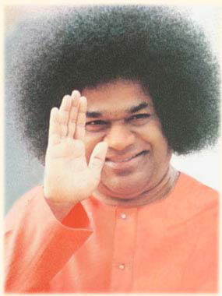
Finish with Om Shanti Shanti Shanti.

